Slide 1
the waters around us
Maruša Malovrh, Eva Ribičič, Tadeja Pavšek

Slide 2
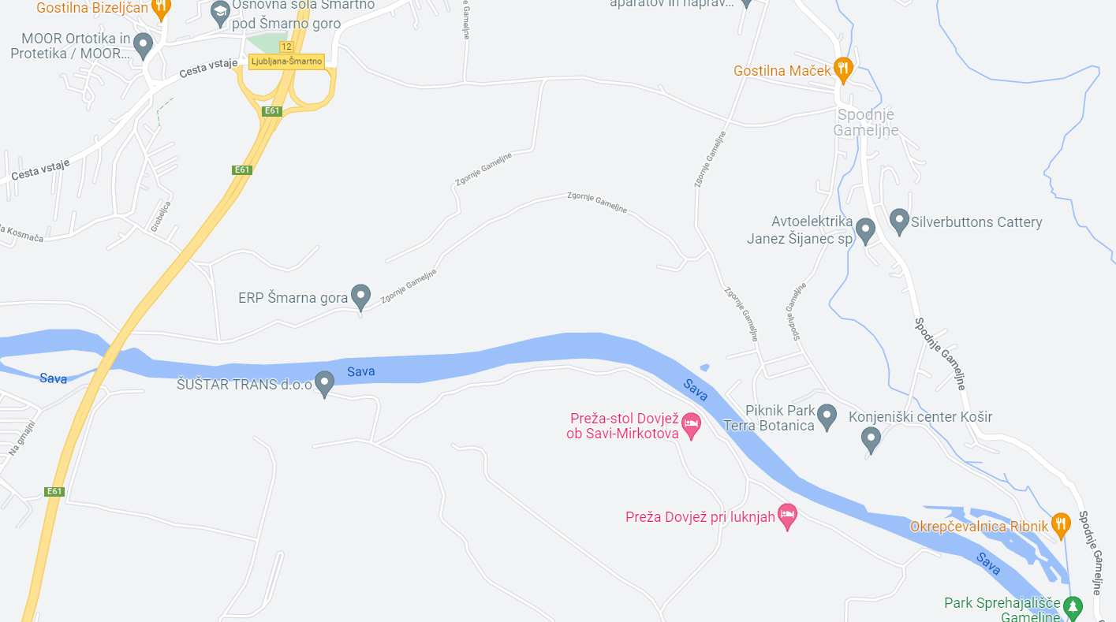
LOCAL WATERCOURSES
Reka Gameljščica
Reka Sava

Slide 3
BLACK SPOTS ON THE SAVA AND GAMELJŠČICA RIVERS
SAVA:
In the 1990s, the Sava was one of the most polluted rivers in Slovenia.
It was burdened mainly by industry and cities that did not even have sewage treatment plants at the time.
The water also contained higher levels of heavy metals.
Until Ljubljana had a sewage treatment plant, the Sava below the Ljubljanica estuary was in the worst quality class.
It received discharges from mines, industry and urban sewage.
Today's situation is incomparable to then.
In 2010, the chemical status of the Sava was good throughout its course through Slovenia and the ecological status of the river was good to very good, with the exception of a few short stretches where the status was assessed as moderate.
The Sava River is improving due to the reduction of industrial pollution and the construction of sewage treatment plants

Slide 4
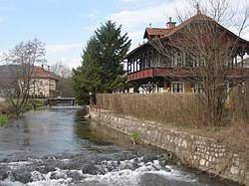
GAMELJŠČICA:
Elevated concentrations of nitrate, nitrite, ammonium, phosphate and chlorides, indicating a direct impact of agriculture and in some cases golf courses and fish farming.

Slide 5
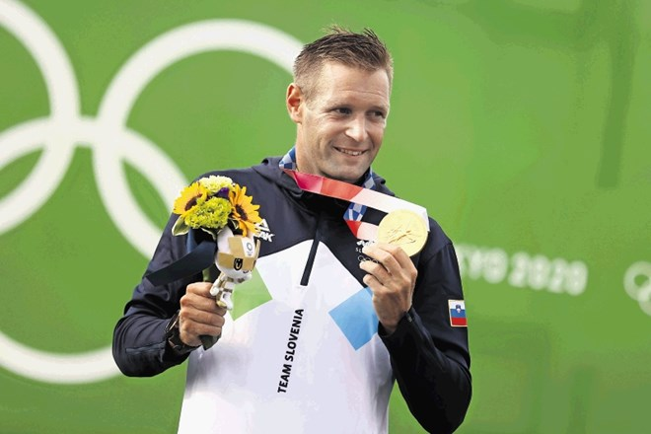
BENJAMIN SAVŠEK (slovenian canoeist, Olympic gold medallist)

Slide 6
INTERVIEW WITH THE GOLD MEDALIST OF THE OLYMPIC GAMES IN TOKYO, BENJAMIN SAVŠEK.
Interviewer:When did you start training kayak and how long have you been training?
I grew up on the Sava River in Brod, in the outskirst of Ljubljana, where I joined the local kayaking club at the age of 8 and started training in this beautiful water sport. I started discovering our beautiful Slovenian rivers through the club's paddling camps, training and preparation. I have been paddling since 1995, and today I am in my 27th year of training in whitewater canoe slalom, and I still enjoy paddling on our rivers just as much.

Slide 7
How did you train on the Sava and how many times a week were you there? When I was at school I was always at training in the afternoon. Every day from Monday to Friday. On weekends we had competitions or training on different rivers in Slovenia. I had a great group of friends in the club. So in the early days, we learnt wild water slalom through playing and by accumulating miles on the rivers and the sea. Today, as a top athlete, I do two training sessions a day on the Sava River, where I have the best conditions for good training.

Slide 8
How did you feel when you received the Olympic gold medal?
It felt great, full of joy and pride that I managed to concentrate several years of effort and work in cooperation with the team into the final performance at the Olympic Games and won. These are definitely the feelings that fill you up and make it worth persevering.

Slide 9
Do you notice any changes on the Sava River over the years (in terms of pollution, traffic, sports use, local people's attitude towards the river, etc.)?
I think that the attitude of the local people towards the Sava river is good and that the initiative of each individual is important in keeping the river clean. Throughout the years, kayakers have also been trying to keep the waters clean, including through various river and riverbank clean-up events, which our clubs organise all over Slovenia. And yes, I think that awareness raising and the preservation of clean waters is well maintained across Slovenia. And it is true that there are still a lot of bathers on the Sava river in the summer, which means that we still have fairly clean rivers. However, as rivers can be very unpredictable, it is important to be responsible and respectful with our activities on and in the river.

Slide 10
What message do you have for the younger generations about the relationship to Slovenian waters and rivers?
Water is a source of life and is a wonderful natural system that allows us to enjoy many activities and water pleasures, so it is worth keeping it clean and as pristine as possible for all future generations.
You can watch one of his performances here. This is about 2‘5 km away from our school so hopefully we‘ll be able to show it to you in person some day.

