Slide 2
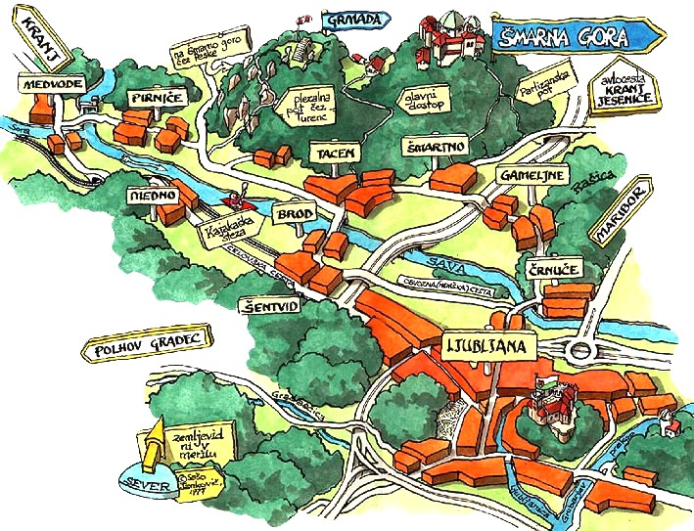
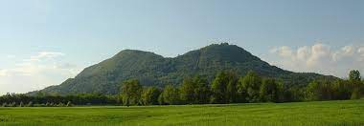
LOCAL watercourses
Šmarna gora district community is a smaller unit of the City of Ljubljana. It covers the areas at the foot of Šmarna gora and Rašica and the northern parts of Ljubljana on the left bank of the Sava River.
The settlements of Gameljne, Rašica, Šmartno and Tacen belong to the community.
Gameljne is divided into Lower, Middle and Upper Gameljne. Rašica is a small clustered village AND Above the village, there IS the MOUNTAIN top of Stane Kosec.
Tacen lies between the river Sava and Šmarna gora HILL on a pebble terrace.
Tacen is also the starting point for Šmarna gora HIKE,
a popular excursion point for many visitors in all seasons.

Slide 3
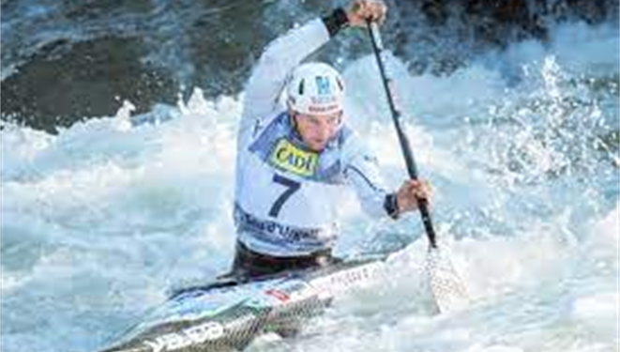
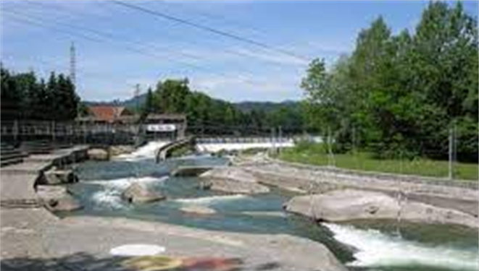
SPORTS ON NEARBY RIVERS
- In 1965 kayak centre „Kajak kanu klub tacen“ was founded
- SINCE then it HAS hosted many world championships:
- 1955, 1991, 2010
- it‘s located in tacen on THE sava RIVER

Slide 4
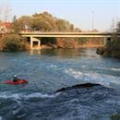
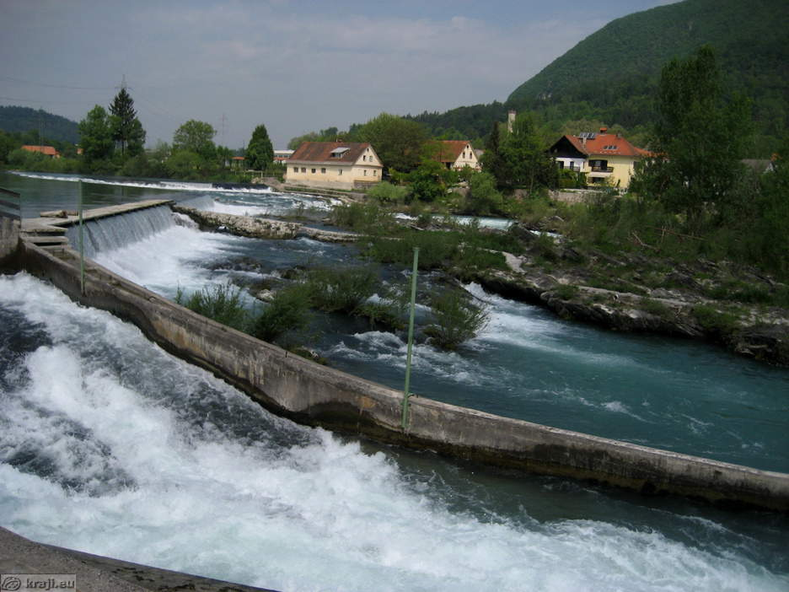
Hydroelectric power plant
LOCATED IN TACEN
MADE BY IGNACIJ ČESEN
IT WAS BUILT BECAUSE POWER PLANT IN LJUBLJANA COULD NOT PRODUCE ENOUGH ELECTRICITY, SO THEY MADE POWER PLANT FOR ŠMARNA GORA DISTRICT COMMUNITY

Slide 5
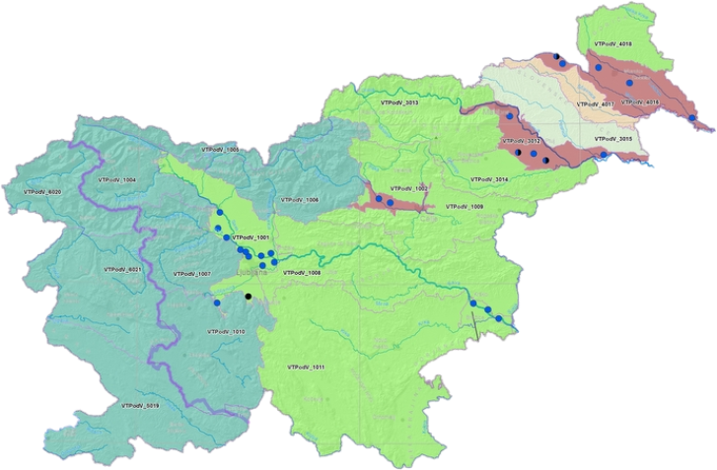
Water pollution
Groundwater resources are under most pressure in the north-eastern lowland areas of Slovenia, in the Drava and Mura Basins.

Slide 6
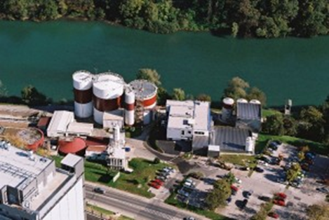
WASTEWATER TREATMENT PLANT
Wastewater treatment plant is used for cleaning water that was polluted.
In slovenia there are many of them.

Slide 7
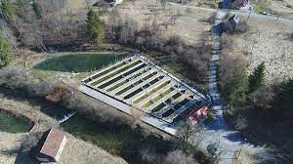
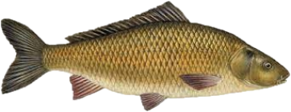
ANImals in Water
Many fish in rivers
There is a fish farm located in gameljne,
Where they breed trouts, graylings and
Other.

Slide 8
Water pollution
ONE OF OUR STUDENTS MADE A VIDEO ABOUT OUR LOCAL RIVER BEING POLUTED DAILY. IT‘A A REAL SHAME BUT WE HOPE OUR PROJECT WILL MAKE PEOPLE AWARE OF THE PROBLEM AND HELP US CHANGE THE ATTITUDE TOWARDS OUR BEAUTIFUL NATURE IN THE LOCAL COMMUNITY.

