Slide 1
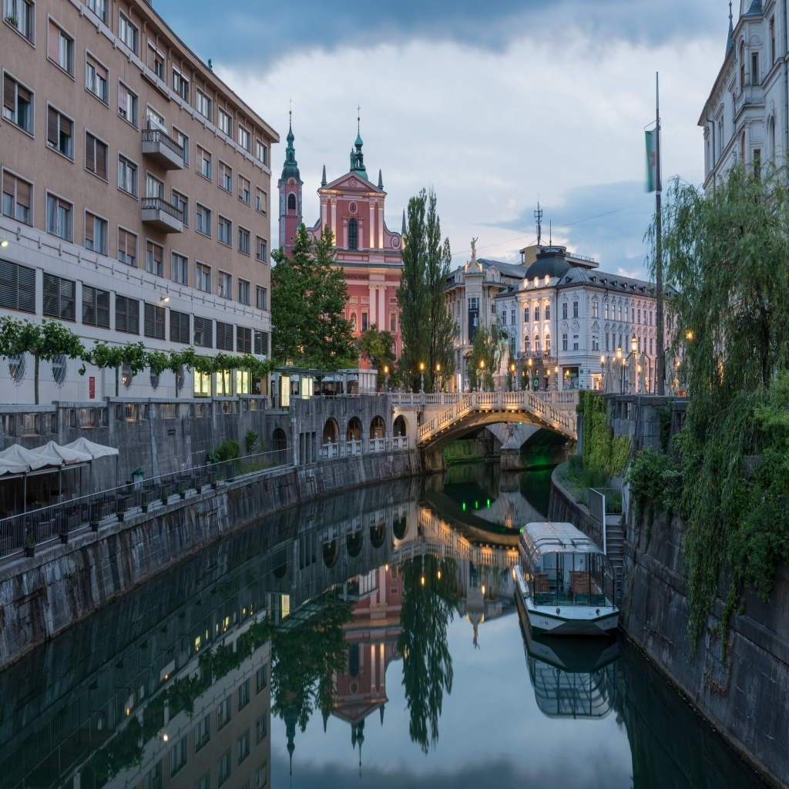
ENERGY PLANTS IN LJUBLJANA

Slide 2
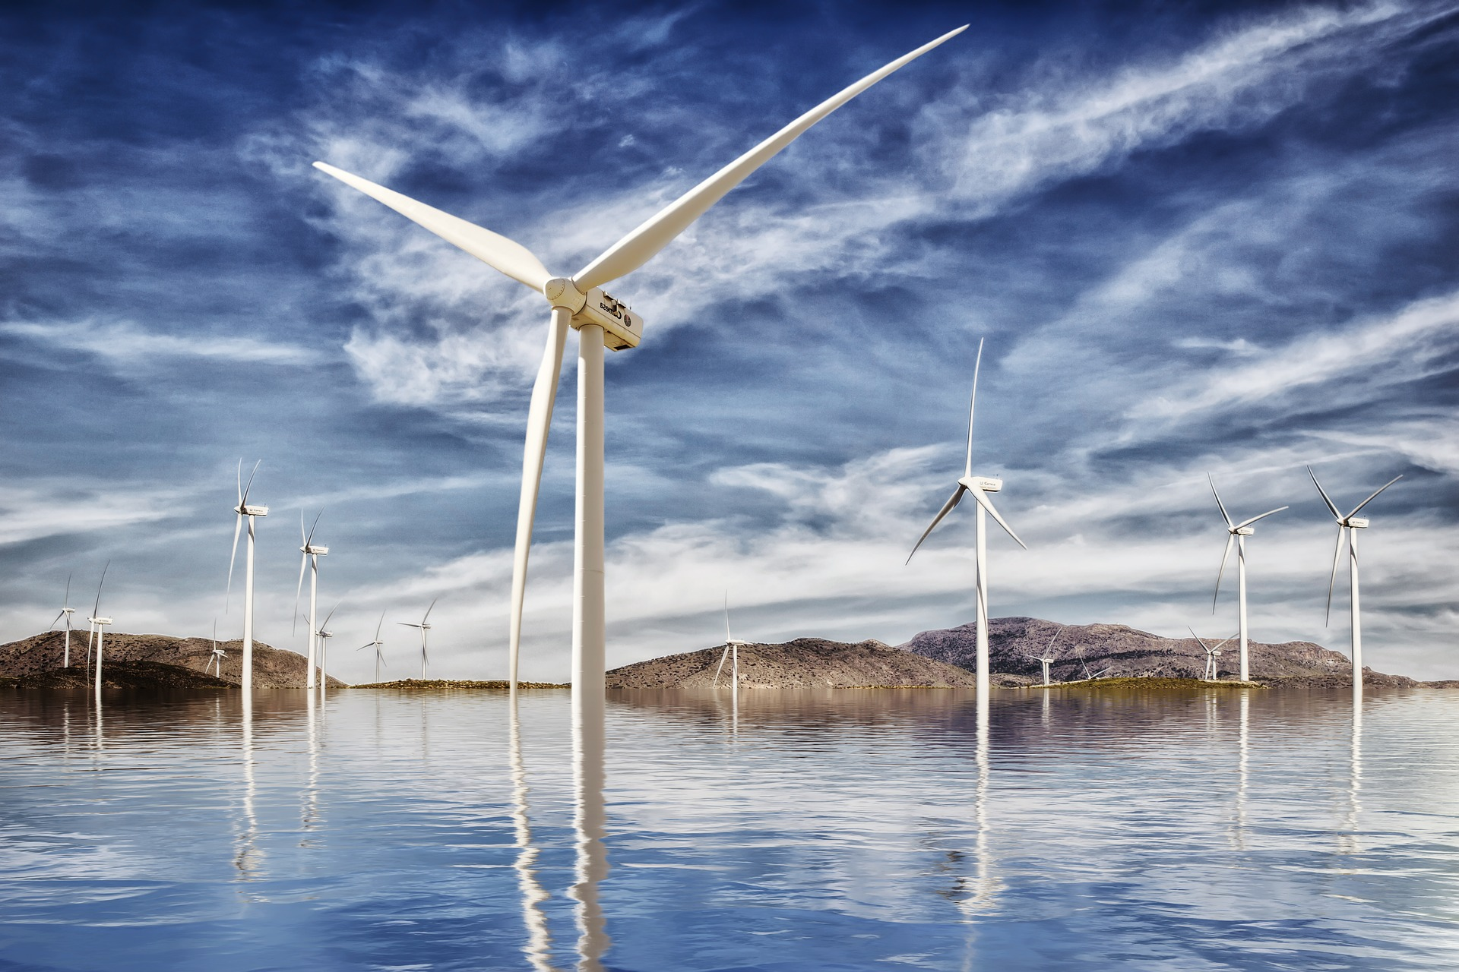
CHARACTERISTICS OF ELECRTICITY
Electricity gives us a better world. We can get it from a variety of sources.
We divide them into several types:
- hydropower plants
- solarpower plants
- windpower plants
Electricity is a co-word for an electric charge, a feature of some elementary particles (e.g., an electron or a proton) that create an electric field around them.

Slide 3
In Ljubljana we have some power plants of each type and these are…

Slide 4
ELEKTRO LJUBLJANA
Renewable energy sources are captured from constant natural processes such as water flow in rivers or streams = HYDROPOWER
Elektro Ljubljana is a technologically advanced company that makes sure that electricity serves people and enables progress.
The introduction of the first lighting in Slovenia: late 19th century
The start of creation of e-mobility : beginning of the 21st century

Slide 5
With district heating they supply more than 64,500 users (used mainly in cities), and sub-heating replaces smaller heating devices in the apartments.
Gas supply = For heating, the preparation of sanitary water is supplied with natural gas by more than 63,000 users. This way is environmentally friendly and more auspicious - it improves the air and doesn‘t harm the atmosphere so much.

Slide 6
The merger of these two companies (ENERGY Ljubljana and TE-TOL) aims at a single company with all activities that is as developmental, organizational and market-efficient as possible in integrated energy supply.
It uses brown coal and wood biomass to produce energy.
Supply: more than 90% of Ljubljana
Produced: Thermal energy 1,252 GWh
Electricity 395 GWh
Energy consumption (coal) 440,000 tonnes
Wood-cut power consumption 63,000 tonnes

Slide 7
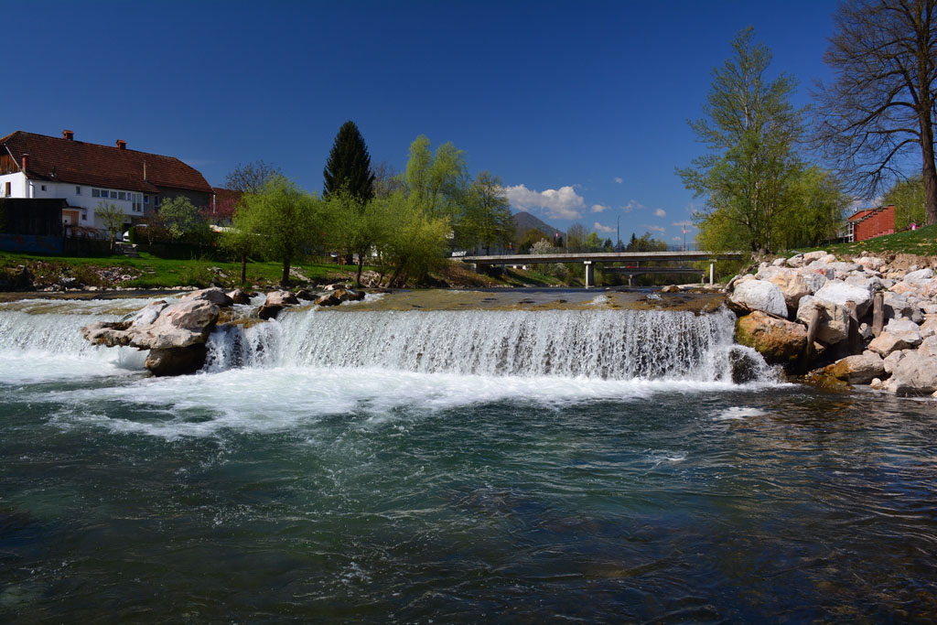
HYDROELECTRIC POWER PLANT - MEDVODE
The Medvode HPP lies above the confluence of the Sava and Sora.
The power plant is equipped with two synchronous, which were restored in 1994 and 1995.
The generators are connected to the six 110 kV switchboard with federal lines.
At the site of the power plant there is also a management center for all hydroelectric power plants on the Sava River and a maintenance center for the chain of hydroelectric power plants on upper and central Sava.

Slide 8
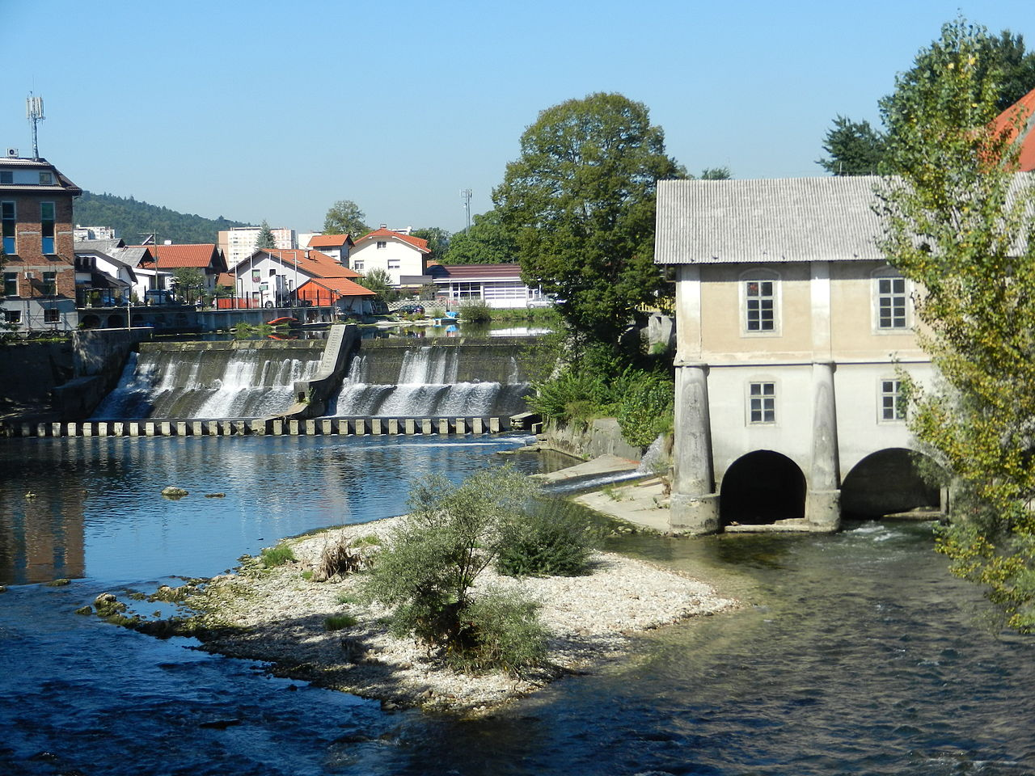
HIDROELEKTRARNA FUŽINE
The Fužine hydroelectric power plant, is a hydropower facility on the Ljubljanica River, which is located on the southern wall of Fužine Castle in the New Fužine.
It started on 14 April 1897 as the first Slovenian power plant on alternating current. It was connected to the first line of 3.1 km in length at the distance from Fužine to Vevče, on which for the first time a three-phase alternating current and transmission of electricity of a voltage of 3 kV were used in Slovenia.
In 1984, it was declared a stationary pillar of local significance.

Slide 9
Investments in the production of electricity from renewable sources are not only part of current trends, but are at the heart of the group's sustainable orientation. All the facilities contain the most advanced technology that enables efficient, reliable and environmentally friendly production of electricity.
In this way, they contribute to a secure and competitive supply of electricity throughout Europe.

Slide 10
THANK YOU FOR YOUR ATTENTION!
Tina E., Emma BŽ., Lara B., Mark G., Julija B.
Teachers: Polona P.P., Aleš V.

